Slide 1
Make it Or Break it
How To Get Community Buy in for Really Hard Stuff
Moolin Seminar
November 18, 2021

Slide 2
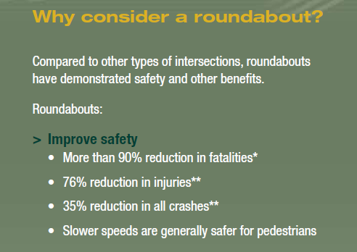
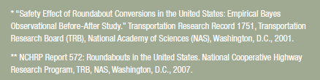
Danby Wembley-2012

Slide 3
Danby-Wembley-2012
Construct a hybrid single/double-lane roundabout at this intersection.
Purpose & Need
Mitigate all crashes at intersection,
primarily highly severity and angle crashes.

Slide 4
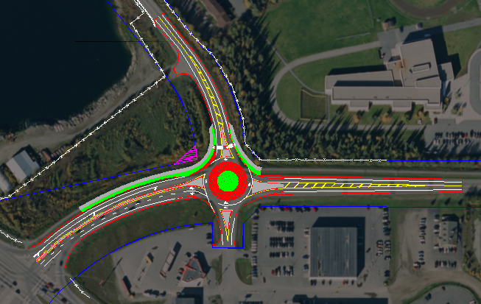
Danby Wembley-2012

Slide 5
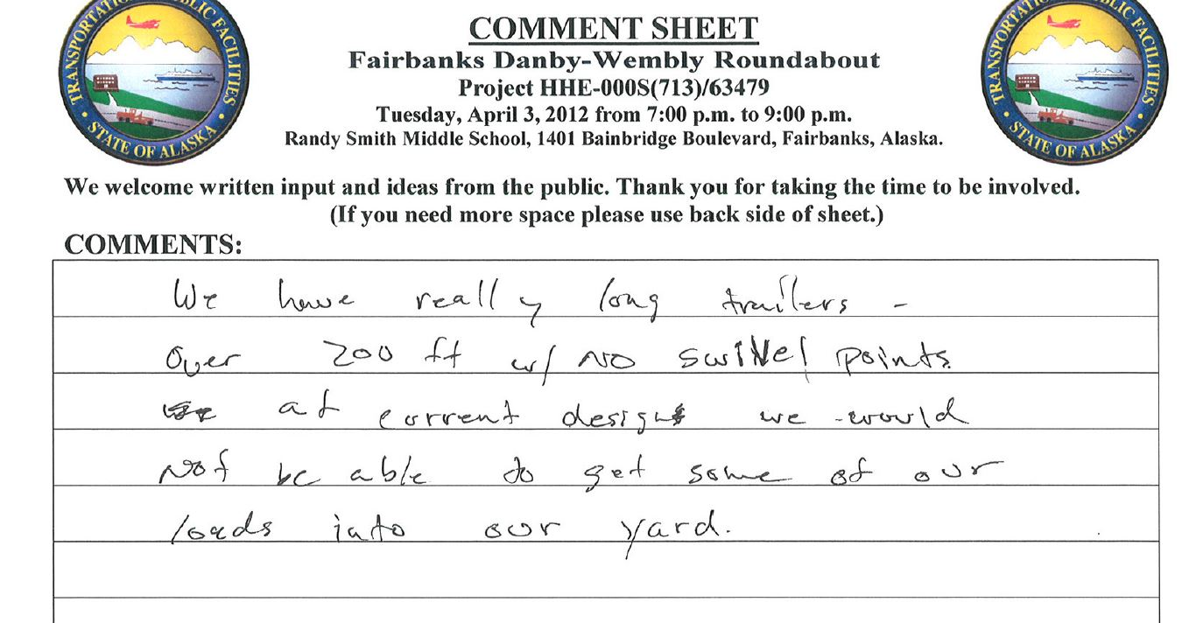
Danby Wembley-2012
  Danby Wembley Roundabout-
  Give me your feedback in two weeks ☺

Slide 6
Alaska Department of
Transportation & Public Facilities
Fairbanks Danby-Wembley Roundabout
Z634790000/000S(173)
August 23, 2016 Public Meeting

Slide 7
Danby Wembley-2016

Slide 8
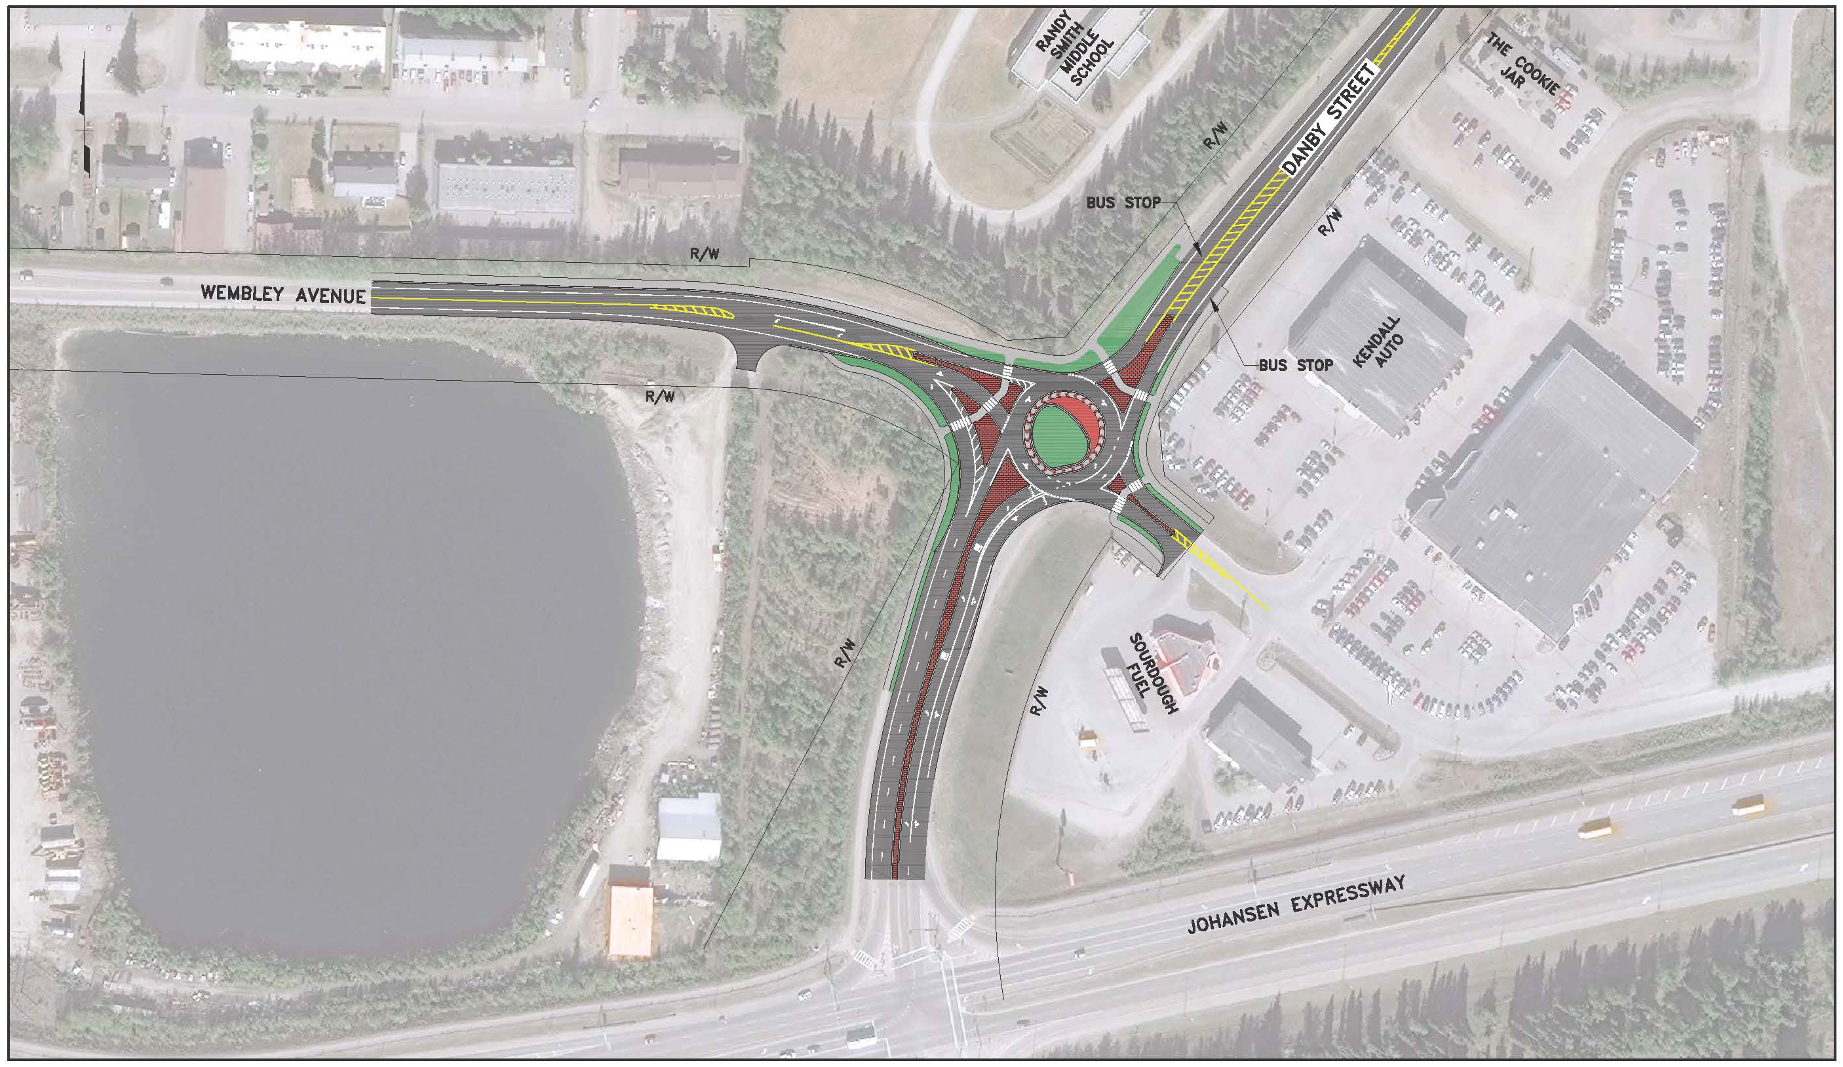
Danby Wembley-2016

Slide 9
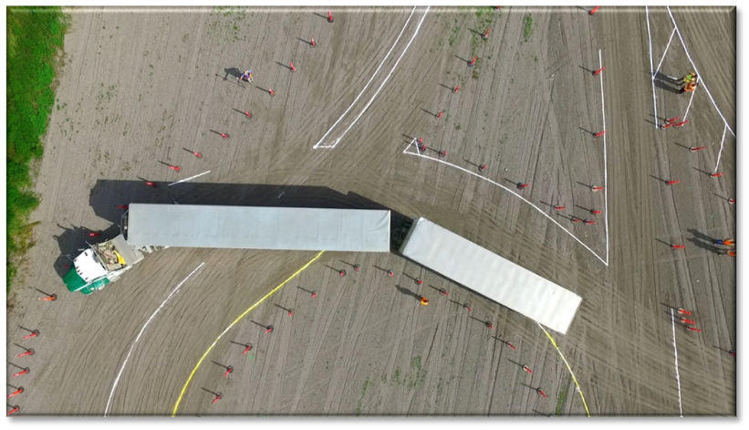
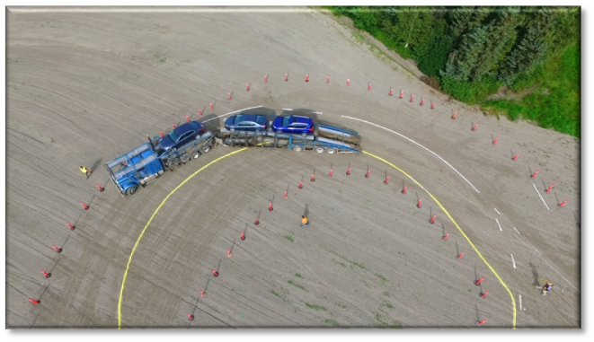
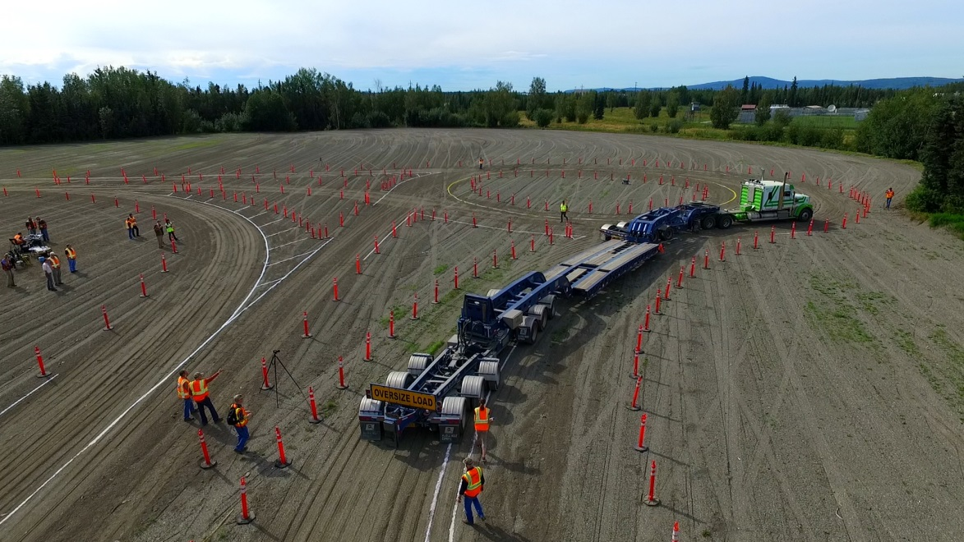
Danby-Wembley 2016
“I was very pleased with this. This is something we’ve been wanting for a long time — to have input into some of the engineering of these projects.”
Jack Binder, Alaska West Express

Slide 10
Wainwright Front Gate-GARS

Slide 11

Hard Put Simple
https://vimeo.com/624782443

